Slide 1
An intellectual revolution means a major change in how people think, understand, and explain the world.

Slide 2
Copernican Revolution (Heliocentric Model)

Slide 3
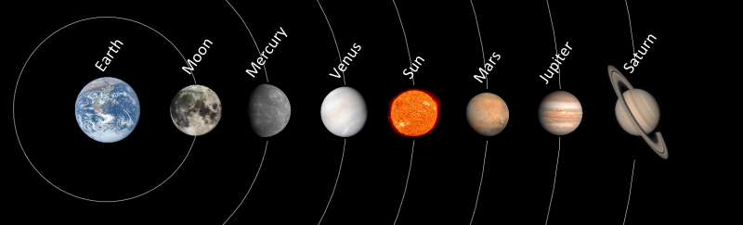
Copernican Revolution
Around 400 BCE, taught that Earth was motionless at the center.
About 150 CE: Ptolemy developed a detailed geocentric system that explained the movements of planets. His model became the standard for over 1,400 years.

Slide 4
The geocentric model is the old idea that Earth is the center of the universe and that everything — the Sun, Moon, planets, and stars — revolves around it.

Slide 5
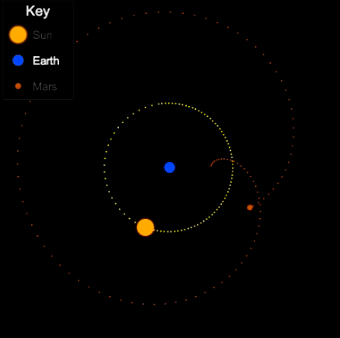
Key Points:
Proposed by Claudius Ptolemy, a Greek astronomer, around 150 CE.
It explained the movements of heavenly bodies using circles within circles (called epicycles).

Slide 6
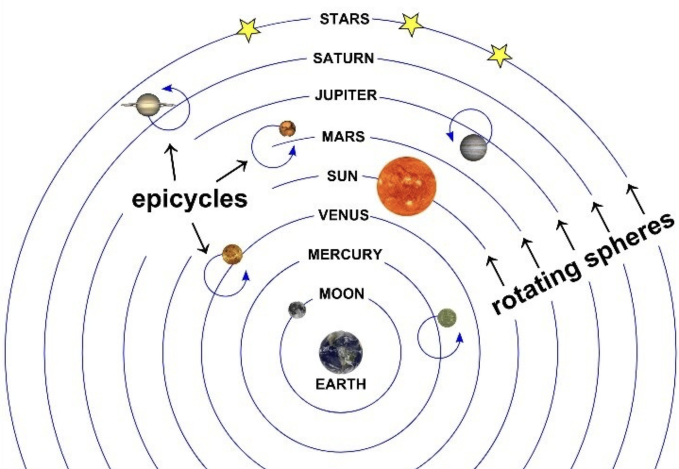

Slide 7
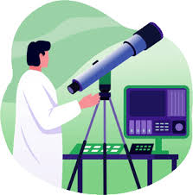
Key Points:
It matched what people could see — the Sun and stars seemed to move around Earth.

Slide 8
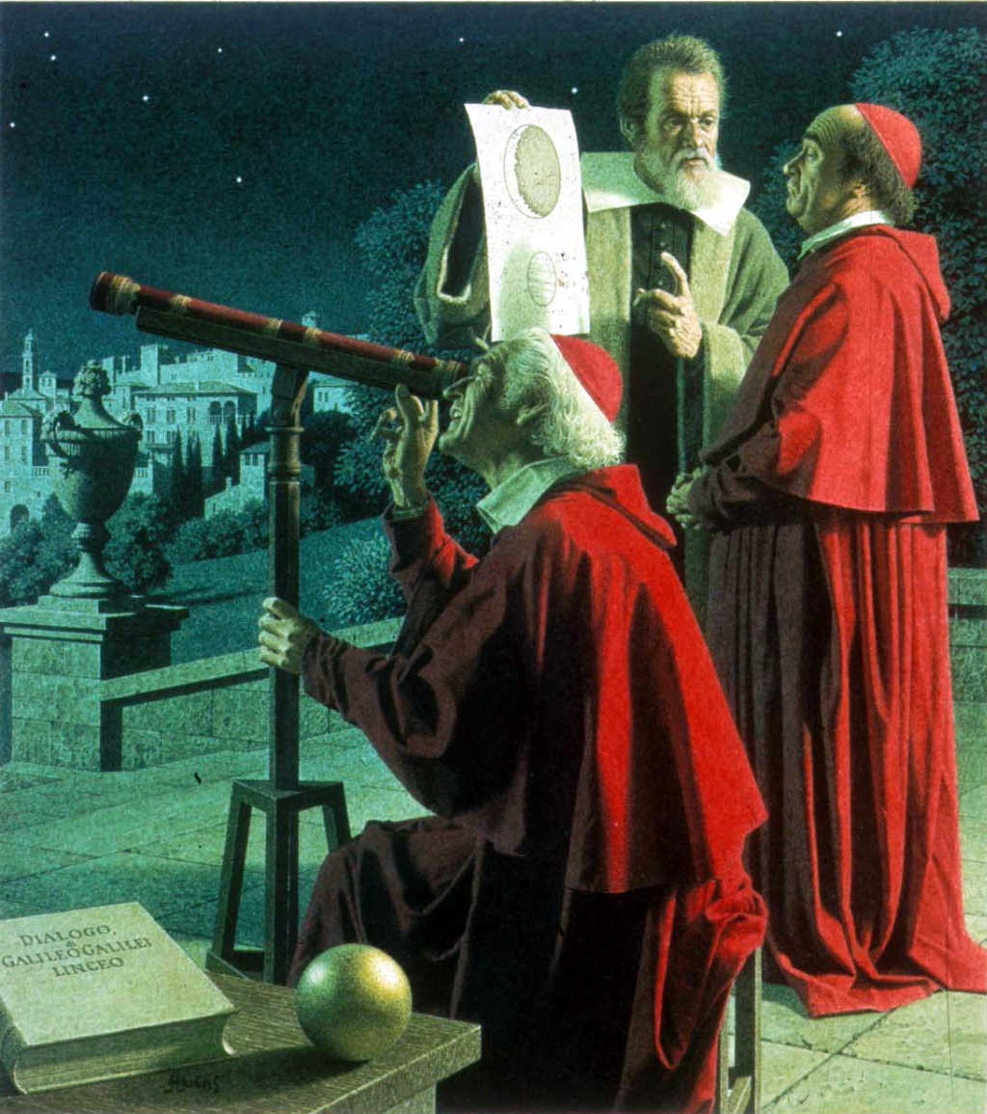
Key Points:
Supported by the Church because it fit the belief that humans and Earth were the center of God’s creation.

Slide 9
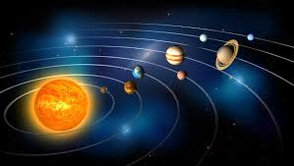
1543: Nicolaus Copernicus published “On the Revolutions of the Heavenly Spheres,” introducing the heliocentric model (sun-centered).
Copernicus believed the sun is the center of the solar system because the Earth-centered model didn’t make sense with what he observed.

Slide 10
Here’s what led him to that conclusion:
Planetary motions were too complicated. The old geocentric model used many circles (called epicycles) to explain why planets sometimes seemed to move backward in the sky. Copernicus noticed that if the sun was at the center, those strange movements could be explained more simply—Earth’s own movement caused the illusion.

Slide 11
2. Mathematical simplicity. His heliocentric model made calculations easier and more accurate. The paths of planets became smoother and more predictable.

Slide 12
3. Retrograde motion made sense. He realized that planets like Mars only appear to move backward because Earth, moving faster, overtakes them in orbit—just like a faster car passing a slower one on the road.

Slide 13
4. Harmony of the system. Copernicus noticed that when he placed the sun at the center, the order of the planets by their speed matched their brightness and observed size changes—showing a logical, harmonious system.

Slide 14
5. Ancient hints. He studied earlier thinkers like Aristarchus of Samos, who centuries before had suggested a sun-centered system. This inspired him to explore the idea scientifically.

Slide 15
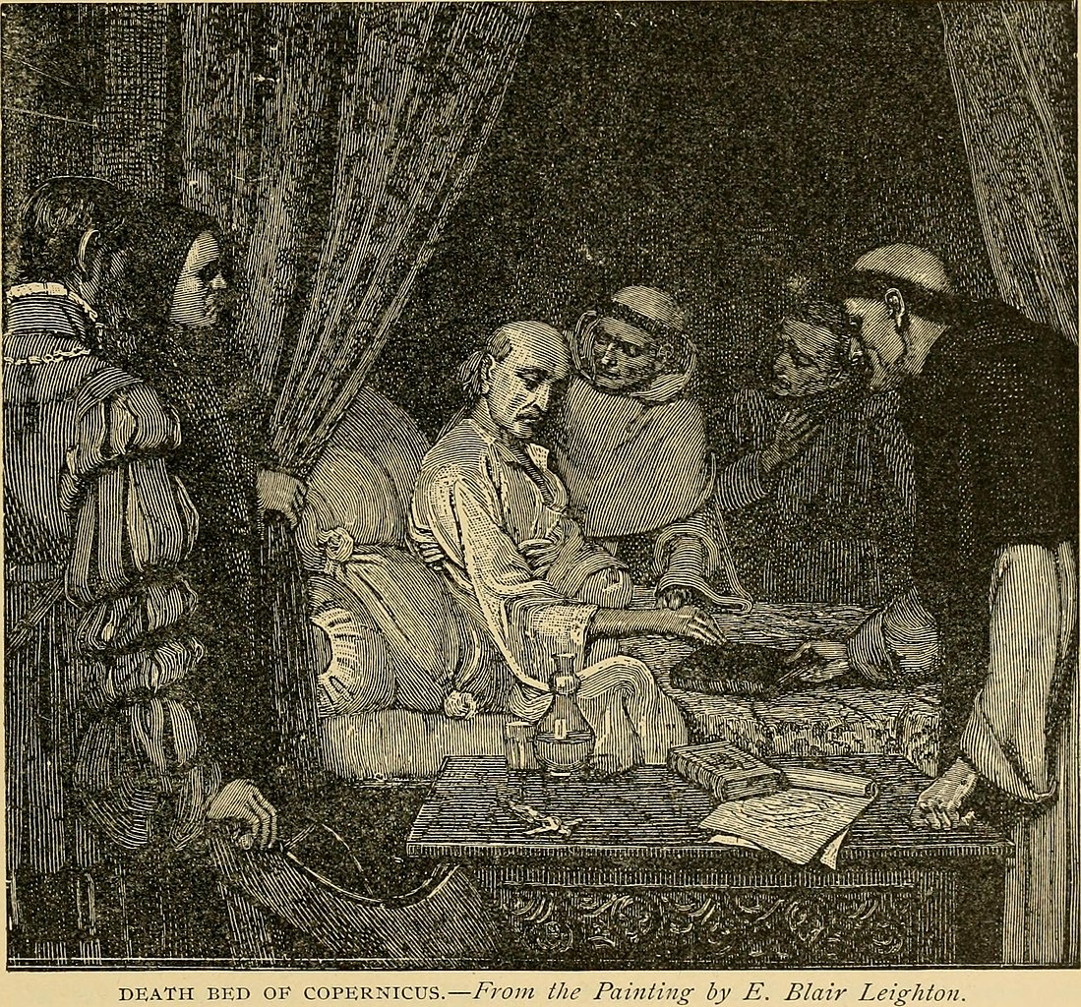
Copernicus did not live to see his work recognized.
He published his book “On the Revolutions of the Heavenly Spheres” in 1543, the same year he died.
According to historical accounts, he received a copy of his book on his deathbed and died shortly after.

Slide 16
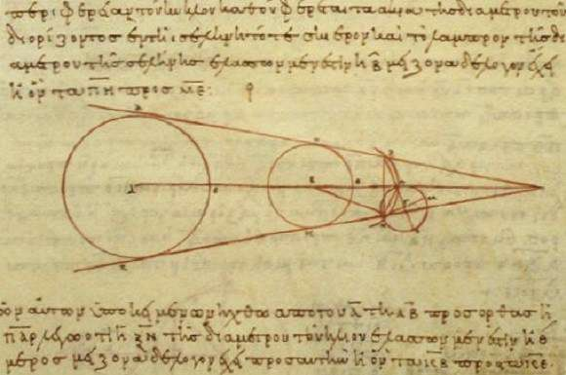
At that time, few people understood or accepted his heliocentric theory.
His ideas were only widely recognized and supported many decades later, through the work of Galileo Galilei, Johannes Kepler, and Isaac Newton, who provided evidence and mathematical proof that the sun-centered model was correct.

Slide 17
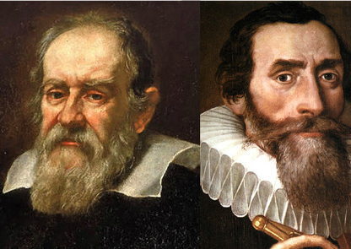
1600s: With the work of Galileo and Kepler, the geocentric idea was finally replaced by the heliocentric model.
So, geocentrism was widely believed from roughly 400 BCE to the 1600s CE — about 2,000 years in total.

Slide 18
Darwinian Revolution (Theory of Evolution)

Slide 19
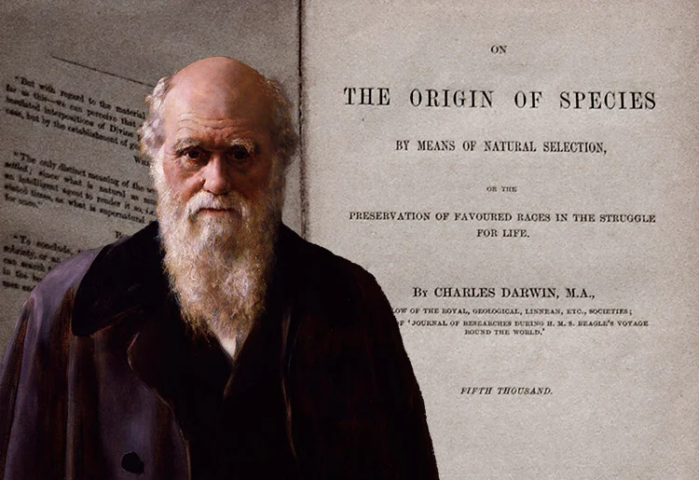
Before Charles Darwin, most people believed species were created separately and never changed. But scientists were finding fossils of strange, extinct animals that looked similar to living ones — suggesting that species might evolve.

Slide 20
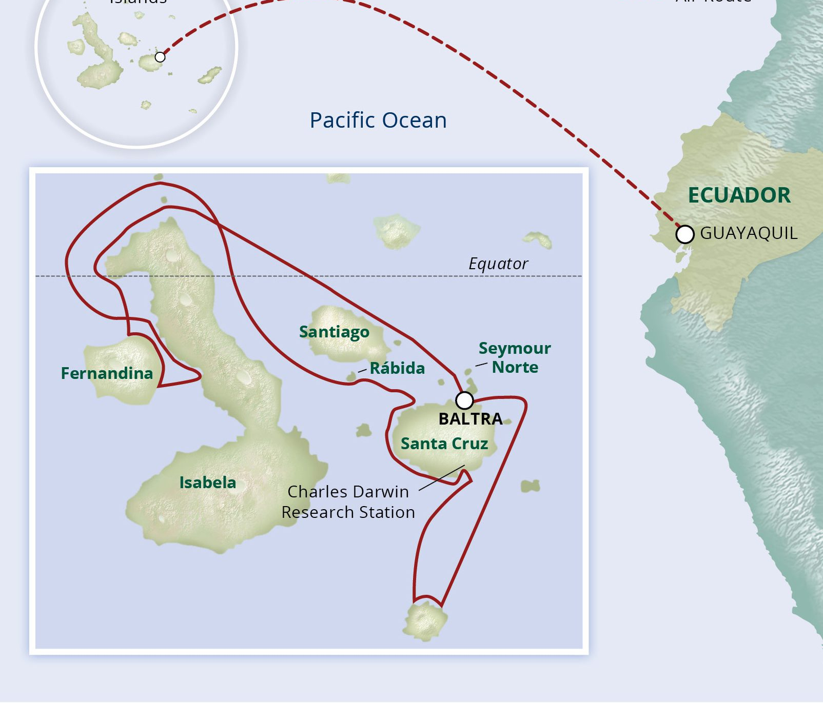
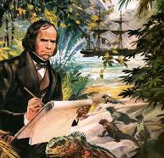
In 1831, Darwin joined a 5-year voyage on the HMS Beagle. He studied plants, animals, and fossils around the world, especially in the Galápagos Islands. He noticed that species varied from island to island — for example, finches had different beak shapes suited to their food sources.

Slide 21
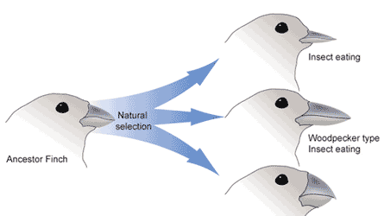

Slide 22
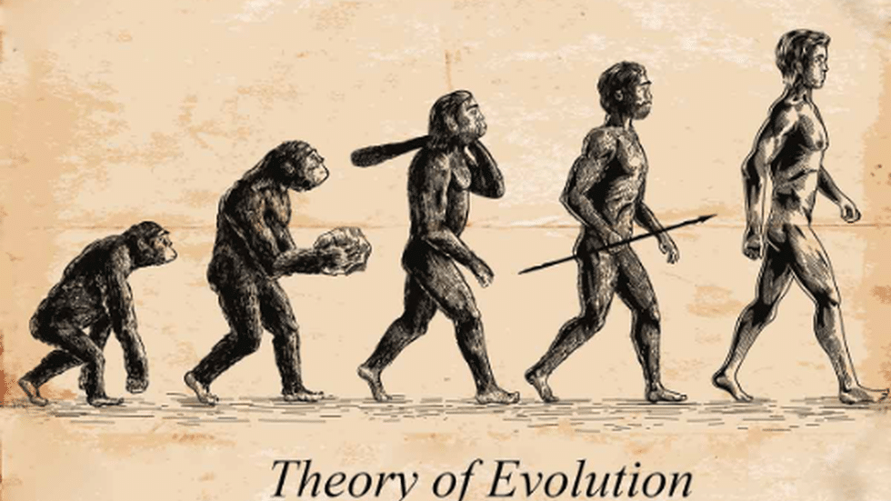

Slide 23
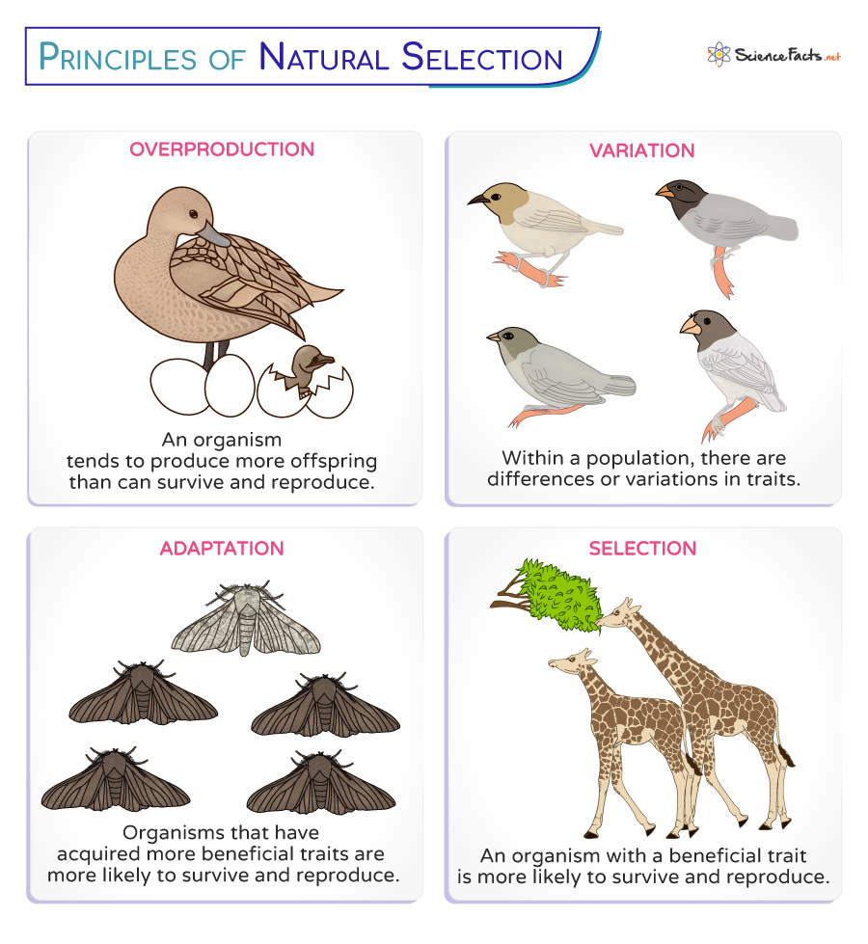
These observations led him to think that species weren’t fixed — they changed gradually. Those with traits better suited to their environment survived and passed those traits on. He called this process natural selection.

Slide 24
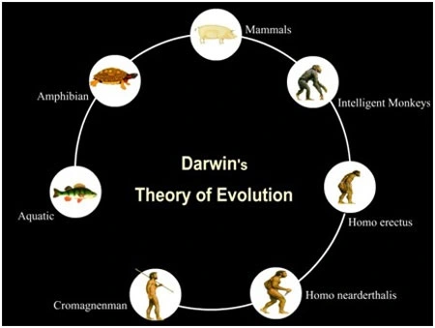
Darwin spent over 20 years gathering evidence. In 1859, he published “On the Origin of Species,” explaining how all species evolve from common ancestors through natural selection.

Slide 25
Freudian Revolution (Psychoanalytic Theory)

Slide 26
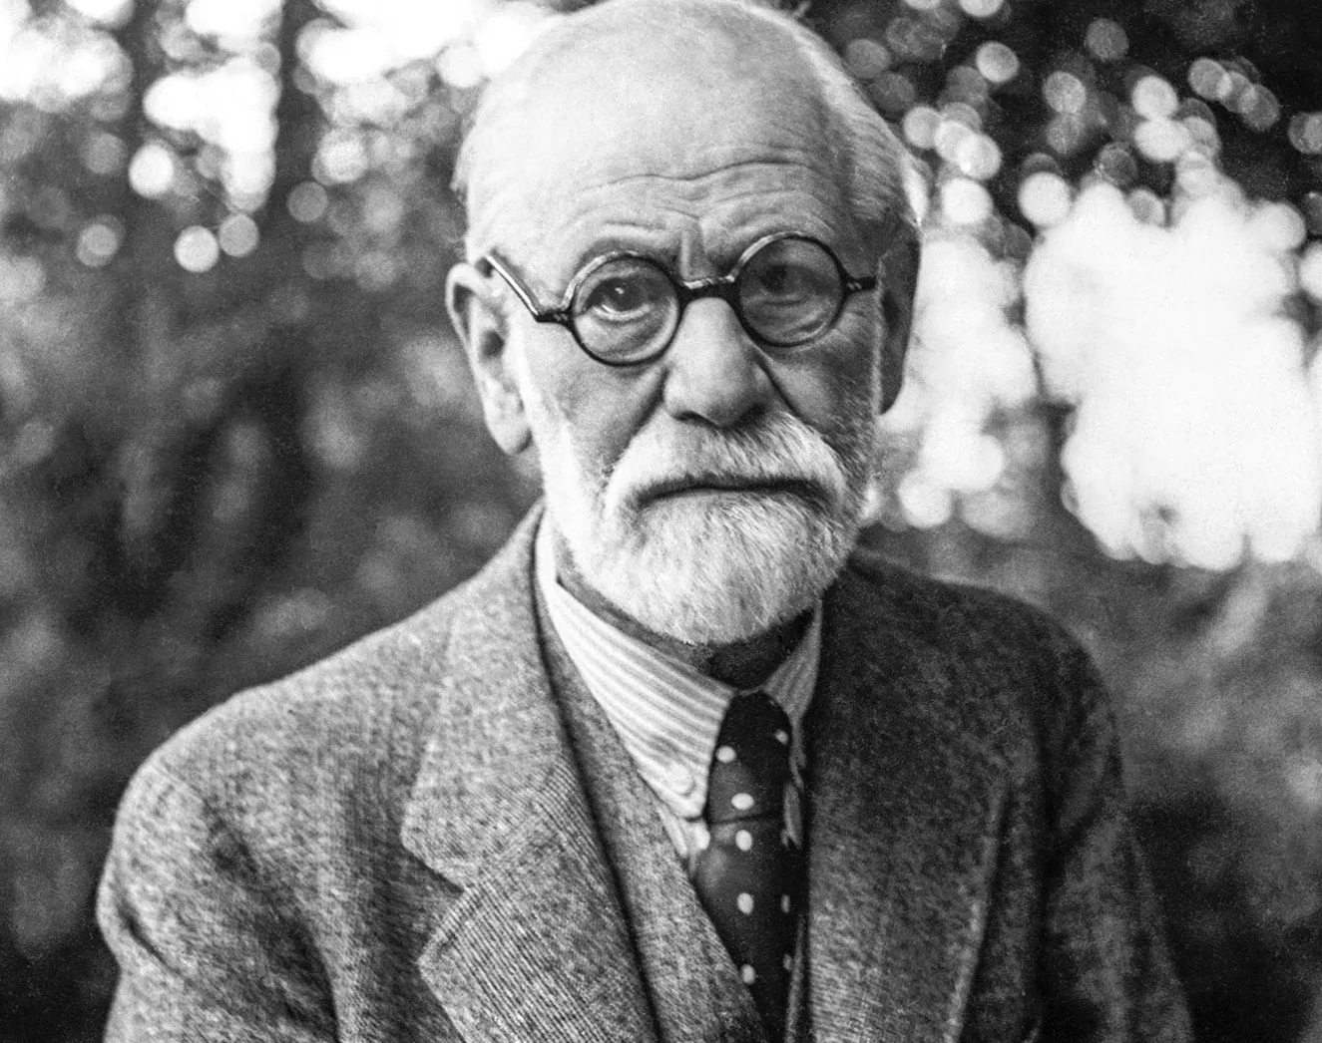
The Freudian Revolution began in the late 19th and early 20th centuries when Sigmund Freud introduced a new way of understanding the human mind and behavior.

Slide 27

The medical background Freud started as a neurologist in Vienna. He treated patients with symptoms (like paralysis or anxiety) that had no physical cause. This led him to suspect that mental and emotional forces were behind their problems.

Slide 28
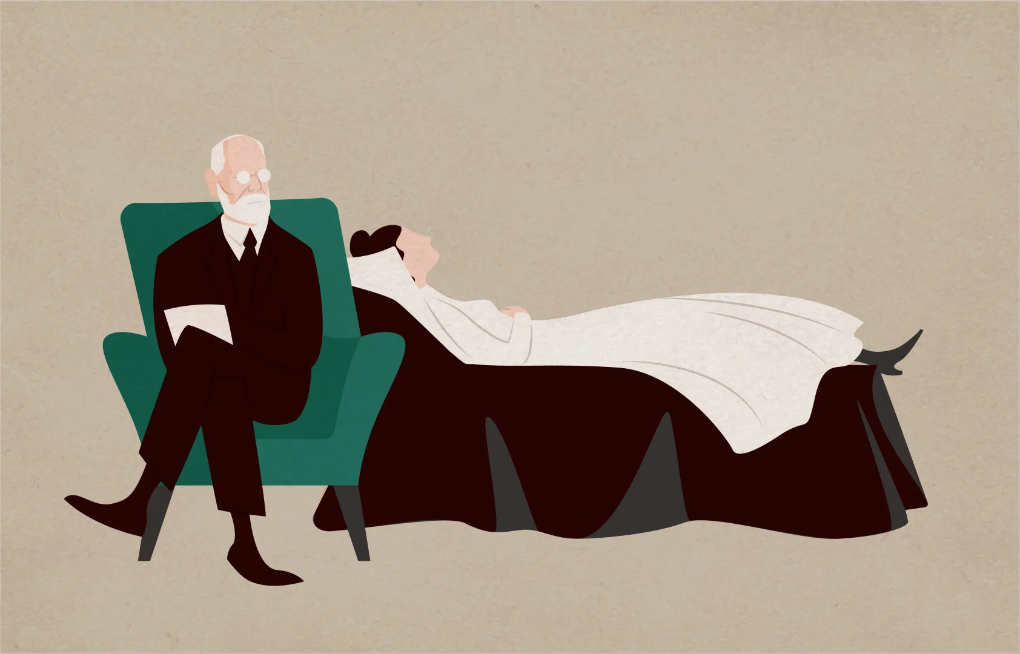
The birth of psychoanalysis Freud developed psychoanalysis, a method that explored the unconscious mind — the hidden thoughts, memories, and desires that influence behavior without our awareness. He used techniques like free association and dream analysis to uncover these hidden motives.

Slide 29
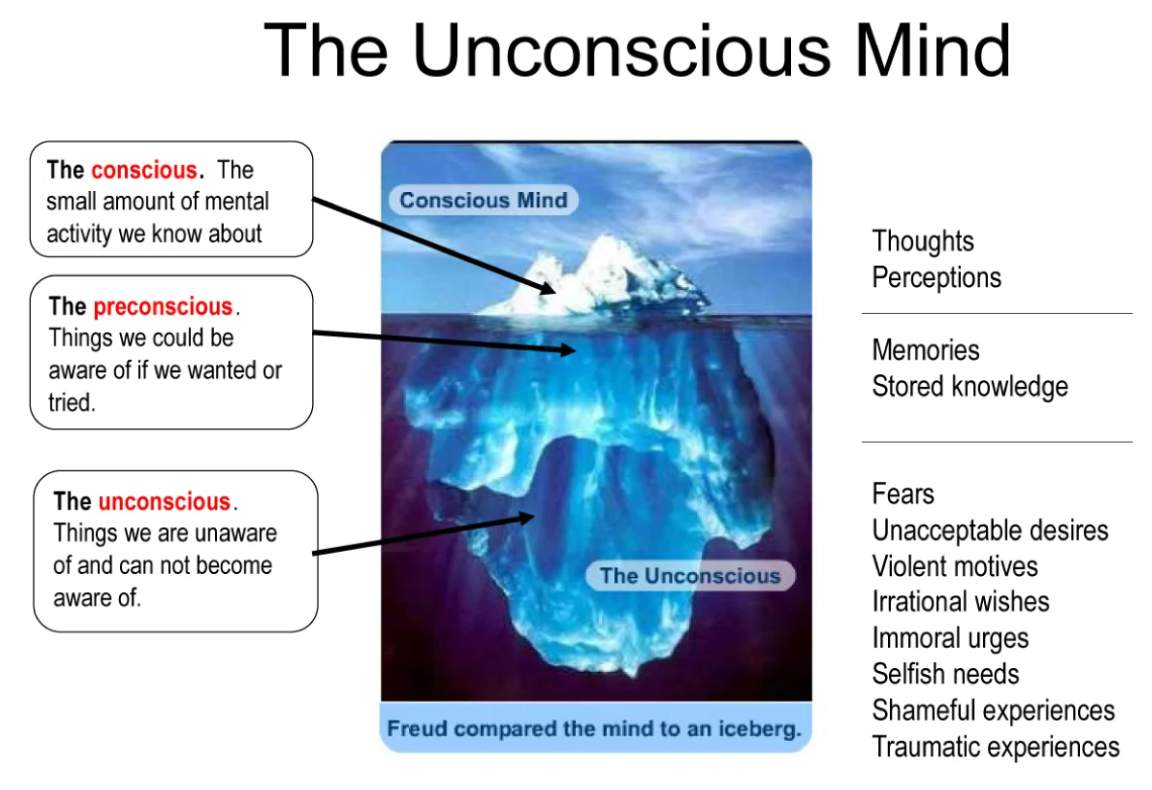
The revolutionary idea Before Freud, most people believed humans acted mainly through logic and reason. Freud argued that much of what we do is driven by unconscious desires, especially those related to childhood experiences and instinctual drives (like sex and aggression).

Slide 30
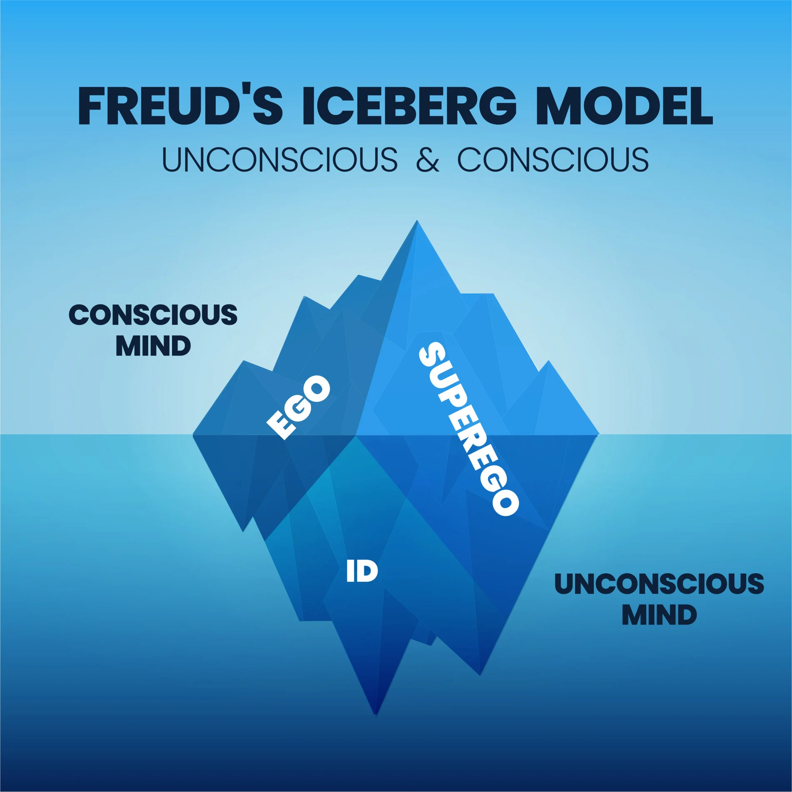

Slide 31
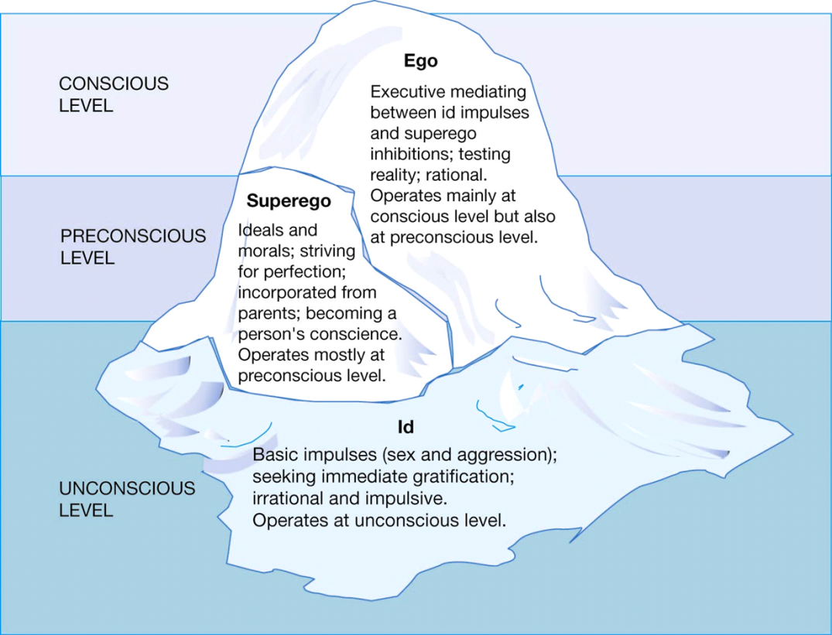

Slide 32
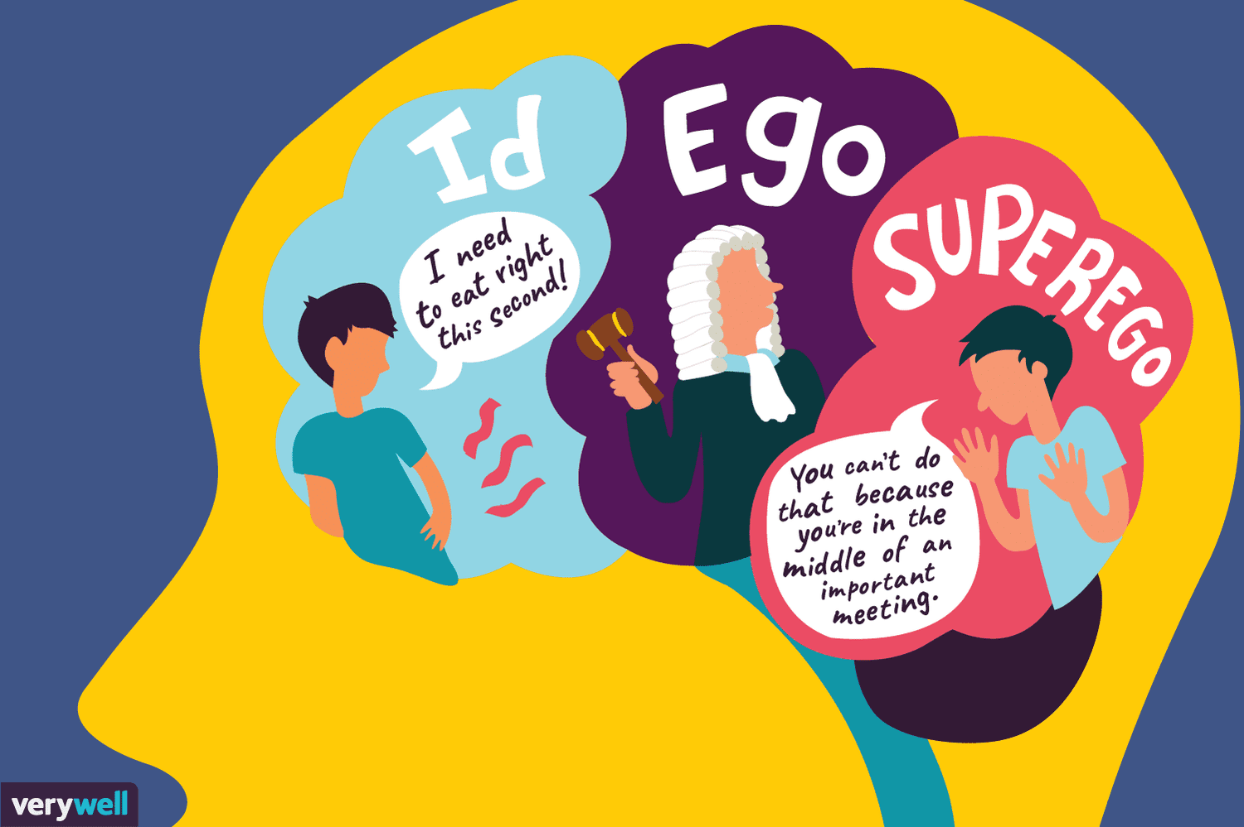

Slide 33
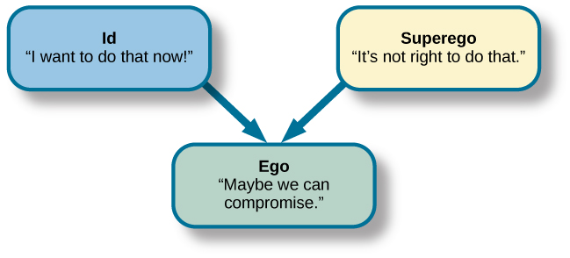

Slide 34

Pedro Alonso López is a Colombian serial killer often called “The Monster of the Andes.”
Born: October 8, 1948, in Tolima, Colombia
Active years: 1970s–1980s
Countries of crimes: Colombia, Ecuador, and Peru
Victims: He claimed to have killed more than 300 young girls, though about 110 were confirmed in Ecuador.
Method: He lured girls—usually between 8 and 12 years old—into remote areas, then assaulted and murdered them.
Capture: Arrested in Ecuador in 1980 after attempting to kidnap a girl.
Sentence: Convicted of 110 murders and sentenced to 16 years in prison (Ecuador’s maximum at the time). Released in 1994.
After release: Deported to Colombia; later re-arrested and released again. His whereabouts have been unknown since 2002.
He is considered one of history’s most prolific serial killers because of the number of claimed victims and the brutality of his crimes.

Slide 35
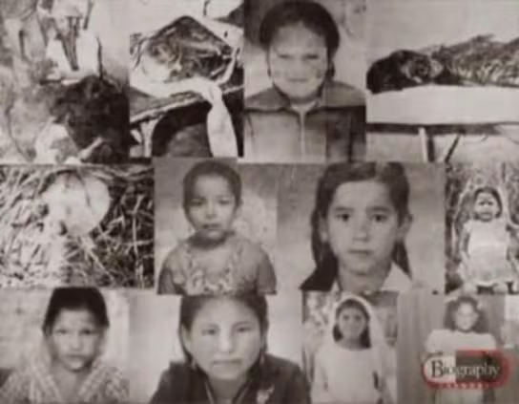
How does psychoanalytic theory explain why he did what he did?

Slide 36

Childhood Trauma and the Unconscious
López reportedly suffered severe abuse and neglect as a child. His mother was a prostitute who allegedly caught him molesting his sister and threw him out at a young age.
According to Freud, such trauma can create repressed anger, fear, and resentment in the unconscious mind. These emotions can later resurface as violent or deviant impulses, especially if they are never resolved or expressed in healthy ways.

Slide 37
Fixation and Regression
Freud believed that people can become “stuck” (fixated) at certain psychosexual stages of development if needs at that stage were not met.
López’s crimes against young girls could reflect a fixation at an early psychosexual stage (the phallic stage, linked to sexual identity and control). His victims’ ages suggest he might have regressed to a stage of development where he sought power or control through domination of children.

Slide 38
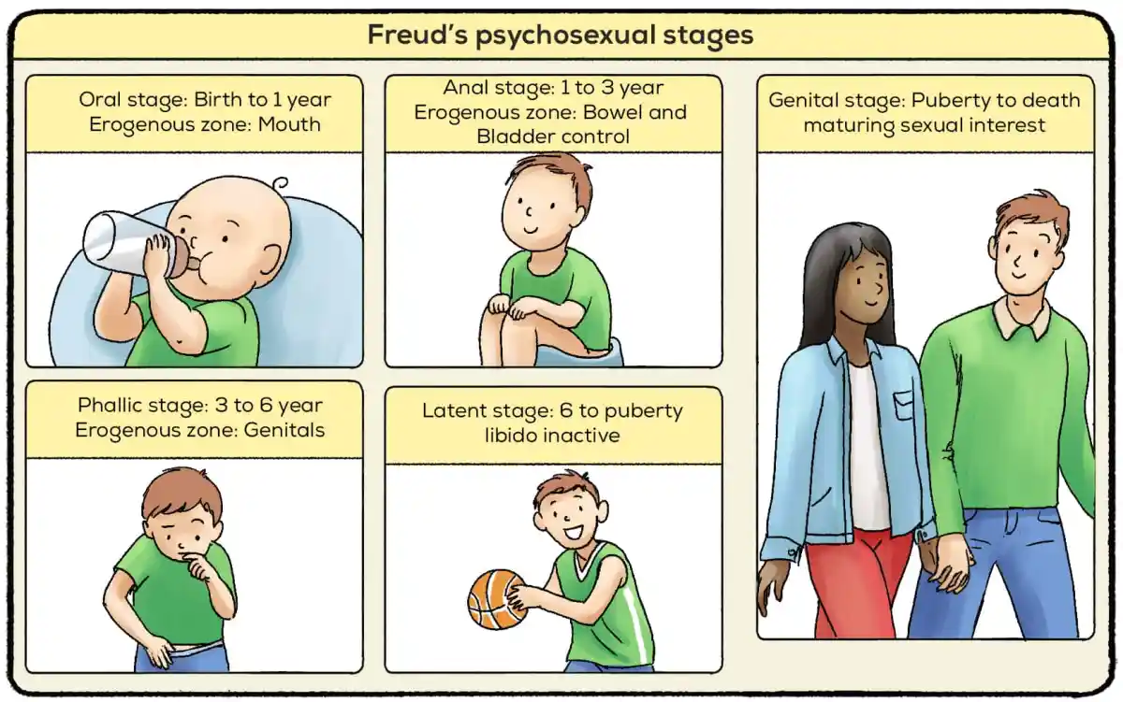

Slide 39
The Id, Ego, and Superego
Id: His primitive drives—sexual desire and aggression—dominated his behavior.
Ego: His rational control (ego) failed to restrain those urges.
Superego: His moral conscience was likely underdeveloped or distorted due to lack of parental guidance and love. With an overactive id and weak ego/superego, López acted impulsively on violent instincts without guilt or empathy.

Slide 40

Defense Mechanisms
López might have used projection (blaming women for his inner rage) or displacement (redirecting anger from his mother toward young girls). These mechanisms protected his ego but fueled his crimes.

Slide 41
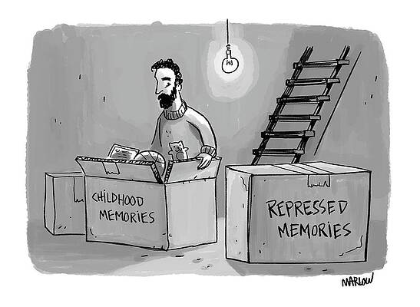
Common Defense Mechanisms
1. Repression
You push painful or unacceptable thoughts out of your conscious mind.
Example: Forgetting a traumatic event because it’s too painful to remember.

Slide 42

Denial
You refuse to accept reality because it’s too uncomfortable.
Example: A smoker refusing to believe smoking is bad for health.

Slide 43

Projection
You blame others for your own thoughts or feelings.
Example: A jealous person accusing their partner of being unfaithful.

Slide 44

Displacement
You take out your anger or frustration on a safer target.
Example: Yelling at family because you’re mad at your boss.

Slide 45
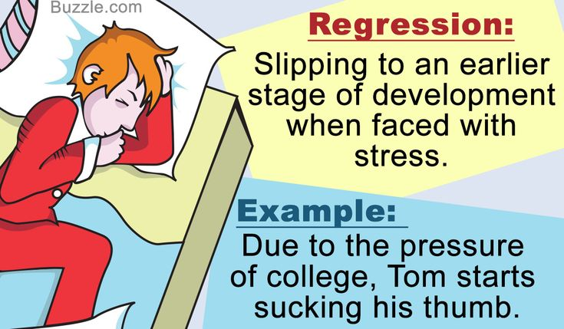
Regression
You return to childish behaviors when under stress.
Example: An adult throwing a tantrum after not getting their way.

Slide 46

Rationalization
You make excuses to justify wrong or disappointing behavior.
Example: Saying you failed an exam because the teacher hates you, not because you didn’t study.

Slide 47
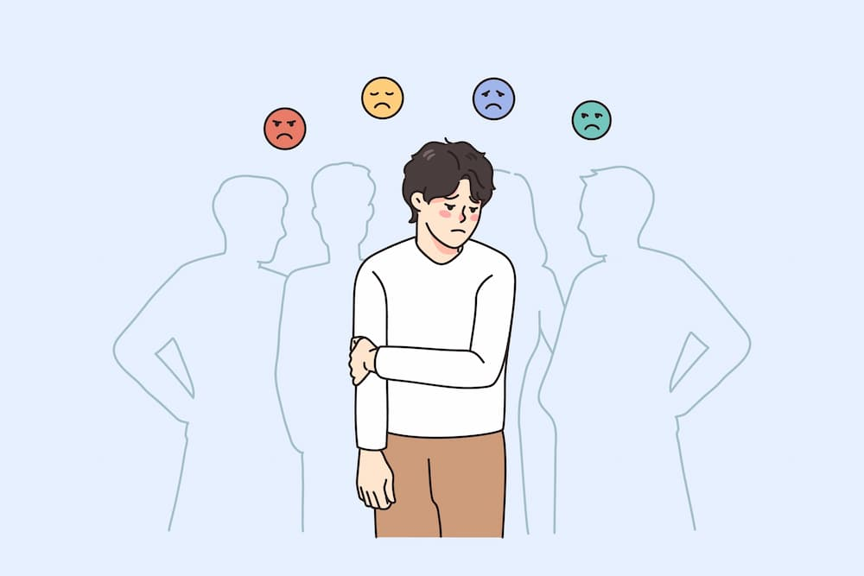
Reaction Formation
You act the opposite of how you really feel.
Example: Treating someone you dislike with extreme kindness.

Slide 48

Sublimation
You turn unacceptable urges into acceptable actions.
Example: Channeling anger into sports or art instead of violence.

Slide 49

Compensation
You focus on strengths to make up for weaknesses.
Example: A student poor in academics excelling in sports.

Slide 50

Identification
You imitate someone you admire to feel stronger or more accepted.
Example: A child copying a favorite teacher’s behavior.

Slide 51
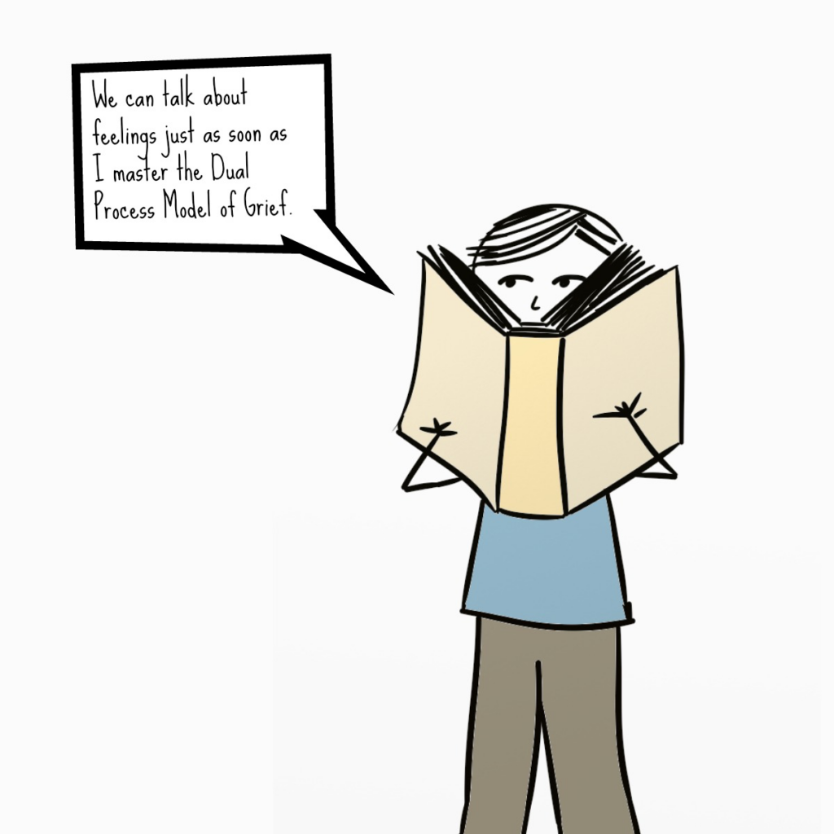
Intellectualization
You focus on facts and logic to avoid emotions.
Example: Talking about a loved one’s death using medical terms instead of expressing grief.

Slide 52
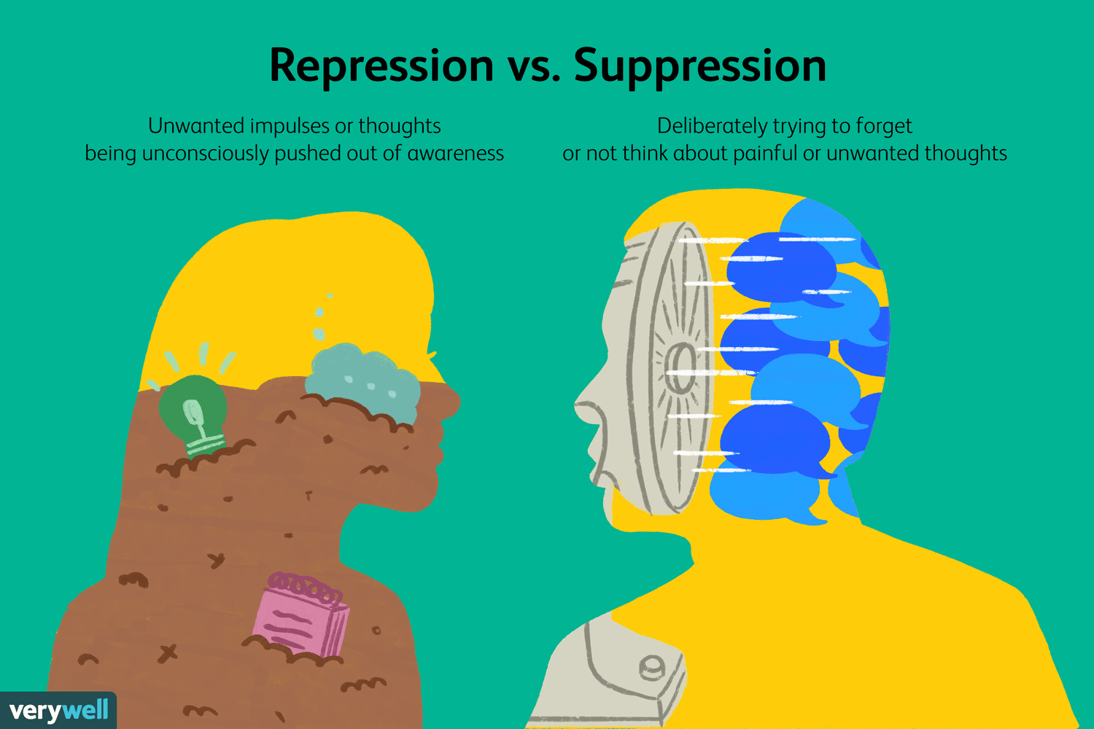
Suppression
You consciously choose to set aside upsetting thoughts (unlike repression, which is unconscious).
Example: Deciding not to think about a fight until you’ve calmed down.

Slide 53
Turing’s Revolution (Theory of Computation)

Slide 54
Mathematicians were trying to answer a big question called the “decision problem” (Entscheidungsproblem) — could there be a single method or machine that decides whether any mathematical statement is true or false?

Slide 55
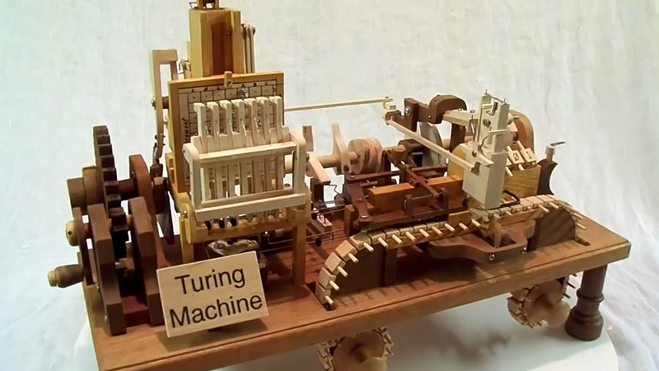
Turing’s idea (1936) Turing imagined a simple, abstract machine that could perform any calculation if given the right instructions — later called the Turing Machine.

Slide 56
A Turing machine is a simple model of a computer, created by Alan Turing in 1936. It’s not a physical machine but a theoretical concept that helps explain how computation works.
How it Works
A Turing machine has three main parts:
Tape – an infinite strip divided into cells. Each cell holds one symbol (like 0, 1, or blank). It acts as the machine’s memory.
Head – reads and writes symbols on the tape and can move left or right one cell at a time.
Control unit (state machine) – a set of rules that tells the machine what to do based on:
what symbol it reads, and
what state it’s currently in.

Slide 57
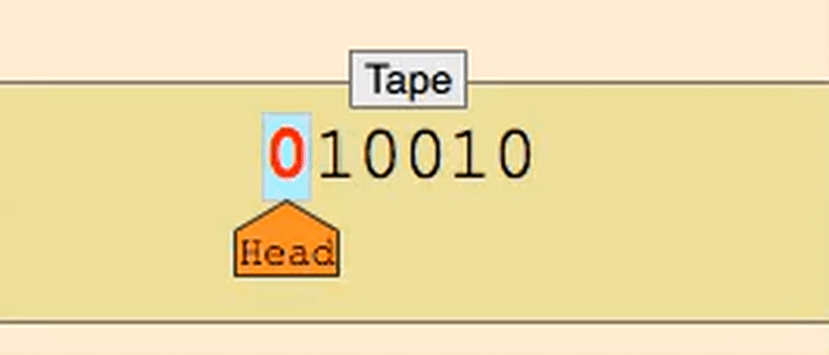
Process:
The head reads a symbol on the tape.
Based on its current state and the symbol read, it:
writes a new symbol (or overwrites it),
moves the head left or right, and
switches to a new state.
The process repeats until it reaches a halt state.

Slide 58
What It’s For
The Turing machine was designed to show what can (and cannot) be computed. It’s used for:
Explaining computation: It defines what it means for something to be “computable.”
Building modern computers: All modern computers are based on this same logic—reading, writing, and processing data step by step.
Studying algorithms: Computer scientists use Turing machines to prove whether problems can be solved by any computer program.

Slide 59
Simple Example
Imagine a Turing machine that adds two binary numbers. It reads the bits on the tape, processes them one by one according to its rules, writes the result, and halts when done.
In short, a Turing machine is a simple but powerful idea that shows how any computer or algorithm works—by following a sequence of logical steps using symbols on memory.

Slide 60
The Turing Revolution is significant because it laid the foundation for modern computing and artificial intelligence. Here’s a clear summary:
1. Defined What “Computation” Means
Before Turing, no one had a precise idea of what it meant to “calculate” or “compute.” His Turing machine model (1936) formally described how a machine could follow rules to solve any problem that can be computed. → This became the theoretical basis of all computers.

Slide 61
2. Inspired Modern Computers
Turing’s model showed that a simple machine could simulate any other machine. This led to the concept of the “universal machine” — what we now call a general-purpose computer. → Every laptop, phone, and server works on the same principle Turing described.

Slide 62
Advanced Artificial Intelligence
In 1950, Turing proposed the idea that machines could “think” and created the Turing Test to measure AI behavior. → This started the entire field of AI research.

Slide 63
Changed Cryptography and Wartime Technology
During World War II, Turing helped break the German Enigma code, saving millions of lives. → His methods showed the real-world power of logical computation.

Slide 64
Shaped Computer Science and Logic
Turing’s work connected mathematics, logic, and engineering, proving that many problems could be analyzed through computation. → It made computer science an academic discipline.

Slide 65
The Turing Revolution transformed abstract logic into practical machines. It defined what computers are, how they think, and how they can solve problems — shaping the digital world we live in today.

